Slide 1
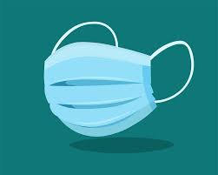
Wearing a mask keeps everyone safe

Slide 2
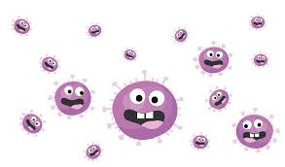

Right now there is a virus called Coronavirus or COVID-19. I can’t see the virus because it’s very small.

Slide 3
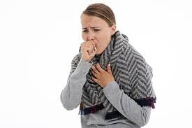
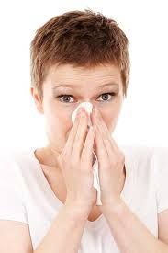

The virus can go from one person to another when someone sneezes, coughs or is standing/sitting too close to another person.

Slide 4
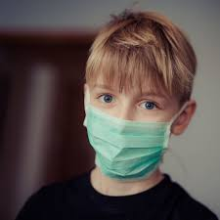
I can help people stay safe from the virus by wearing a mask! Wearing a mask keeps me, my family, friends and neighbors all safe.

Slide 5
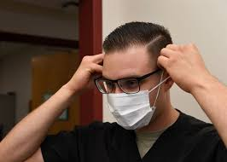
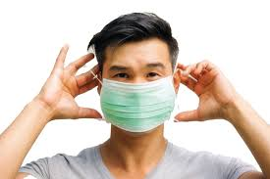
It might feel different or uncomfortable at first to wear a mask. But, I can practice wearing my mask. It has to cover my nose and mouth. After some practice, it will be so easy to wear one.

Slide 6
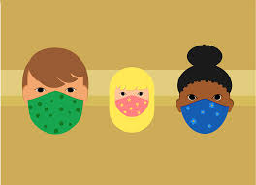
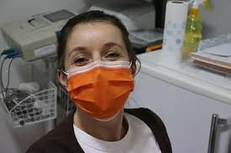
When I go outside or to a store, I might see other people wearing masks, too. Everyone is helping each other stay safe from the virus.

Slide 7
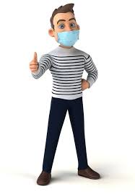
Wearing a mask keeps everyone safe!

